Slide 1
Addressing Modes

Slide 2
Chapter Objectives
Explain the operation of each data-addressing mode.
Use the data-addressing modes to form assembly language statements.
Explain the operation of each program memory-addressing mode.
Use the program memory-addressing modes to form assembly and machine language statements.
Select the appropriate addressing mode to accomplish a given task.
Detail the difference between addressing memory data using real mode and protected mode operation.
Describe the sequence of events that place data onto the stack or remove data from the stack.
Explain how a data structure is placed in memory and used with software.

Slide 3
data-addressing modes
register, immediate, direct, register indirect, base-plus index, register-relative, and base relative-plus-index in the 8086 through the 80286 microprocessor. The 80386 and above also include a scaled-index mode of addressing memory data.
program memory-addressing modes
program relative, direct, and indirect.

Slide 4
The MOV instruction transfers bytes or words of data between two registers or between registers and memory in the 8086 through the 80286.
Bytes, words, or doublewords are transferred in the 80386 and above by a MOV.
The source is to the right and the destination is to the left, next to the opcode MOV.
An opcode, or operation code, tells the microprocessor which operation to perform.
Move the data from right to left
a comma always separates the destination from the source in an instruction
memory-to-memory transfers are not allowed by any instruction except for the MOVS instruction

Slide 5
Fig 3.1
the MOV AX, BX instruction transfers the word contents of the source register (BX) into the destination register (AX).
The source never changes, but the destination always changes.
MOV instruction always copies the source data into the destination
The flag register remains unaffected by most data transfer instructions.
The source and destination are often called operands

Slide 6
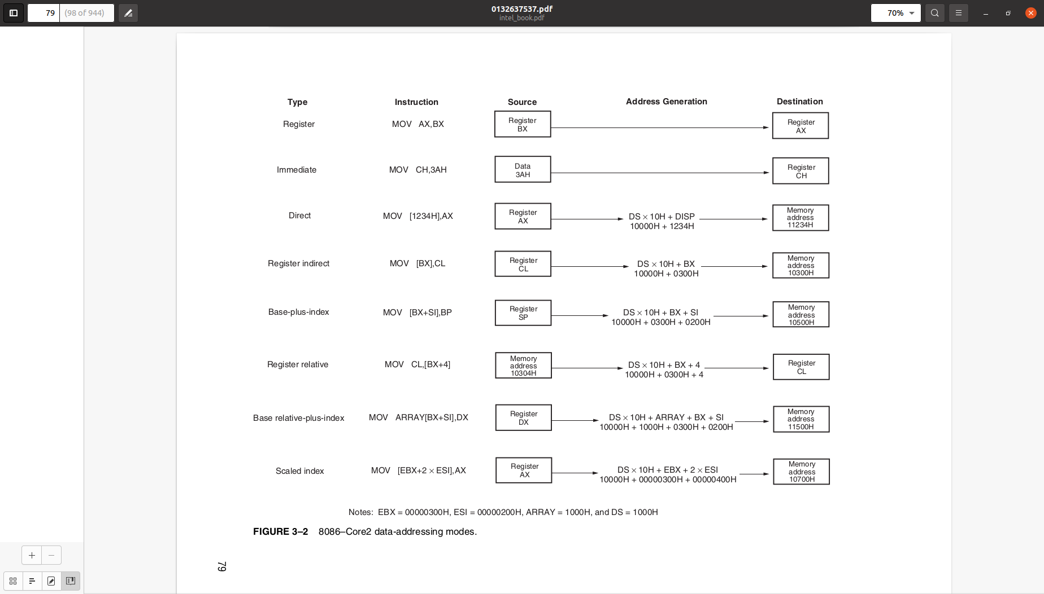
all possible variations of the data-addressing modes using the MOV instruction

Slide 7
Register addressing
Register addressing transfers a copy of a byte or word from the source
register or contents of a memory location to the destination register or
memory location.
The MOV CX, DX instruction copies the word-sized contents of register DX into register CX.
In the 80386 and above, a doubleword can be transferred from the source register or memory location to the destination register or memory location.
Example: The MOV ECX, EDX instruction copies the doubleword-sized contents of register EDX into register ECX.

Slide 8
Immediate addressing
Immediate addressing transfers the source, an immediate byte, word, doubleword, or quadword of data, into the destination register or memory location.
Example: The MOV AL, 22H instruction copies a byte-sized 22H into register AL.
In the 80386 and above, a doubleword of immediate data can be transferred into a register or memory location.
Example: The MOV EBX, 12345678H instruction copies a doubleword-sized l2345678H into the 32-bit-wide EBX register.

Slide 9
Direct addressing
Direct addressing moves a byte or word between a memory location and a register.
The instruction set does not support a memory-to-memory transfer, except with the MOVS instruction.
Example: The MOV CX, LIST instruction copies the word-sized contents of memory location LIST into register CX.
In the 80386 and above, a doubleword-sized memory location can also be addressed.
Example: The MOV ESI, LIST instruction copies a 32-bit number, stored in four consecutive bytes of memory, from location LIST into register ESI.

Slide 10
Register indirect addressing
Register indirect addressing transfers a byte or word between a register and a memory location addressed by an index or base register.
The index and base registers are BP, BX, DI, and S1. (Example: The MOV AX, [BX] instruction copies the word-sized data from the data segment offset address indexed by BX into register AX.)
In the 80386 and above, a byte, word, or doubleword is transferred between a register and a memory location addressed by any register: EAX, EBX, ECX, EDX, EBP, EDI, or ESI. (Example: The MOV AL, [ECX] instruction loads AL from the data segment offset address selected by the contents of ECX.)

Slide 11
Base-plus-index addressing
Base-plus-index addressing transfers a byte or word between a register and the memory location addressed by a base register (BP or BX) plus an index register (DI or SI).
(Example: The MOV [ BX+DI ], CL instruction copies the byte-sized contents of register CL into the data segment memory location addressed by BX plus DI.)
In the 80386 and above, any two registers (EAX, EBX, ECX, EDX, EBP, EDI, or ESI) may be combined to generate the memory address.
(Example: The MOV [ EAX+EBX ], CL instruction copies the byte-sized contents of register CL into the data segment memory location addressed by EAX plus EBX.)

Slide 12
Register relative addressing
Register relative addressing moves a byte or word between a register and the memory location addressed by an index or base register plus a displacement. (Example: MOV AX,[ BX+4 ] or MOV AX,ARRAY[BX].
The first instruction loads AX from the data segment address formed by BX plus 4. The second instruction loads AX from the data segment memory location in ARRAY plus the contents of BX.)
The 80386 and above use any 32-bit register except ESP to address memory. (Example: MOV AX,[ ECX+4 ] or MOV AX,ARRAY[EBX].
The first instruction loads AX from the data segment address formed by ECX plus 4. The second instruction loads AX from the data segment memory location ARRAY plus the contents of EBX.)

Slide 13
Base relative-plus-index addressing
Base relative-plus-index addressing transfers a byte or word between a register and the memory location addressed by a base and an index register plus a displacement.
(Example: MOV AX, ARRAY[ BX+DI ] or MOV AX, [ BX+DI+4 ].
These instructions load AX from a data segment memory location.
The first instruction uses an address formed by adding ARRAY, BX, and DI and the second by adding BX, DI, and 4.)
In the 80386 and above, MOV EAX, ARRAY[ EBX+ECX ] loads EAX from the data segment memory location accessed by the sum of ARRAY, EBX, and ECX.

Slide 14
Scaled-index addressing
Scaled-index addressing is available only in the 80386 through the Pentium 4 microprocessor.
The second register of a pair of registers is modified by the scale factor of 2×, 4×, or 8× to generate the operand memory address.
(Example: A MOV EDX, [ EAX+4*EBX ] instruction loads EDX from the data segment memory location addressed by EAX plus four times EBX.)
Scaling allows access to word ( 2× ), doubleword ( 4× ), or quadword ( 8× ) memory array data. Note that a scaling factor of 1 * also exists, but it is normally implied and does not appear explicitly in the instruction.
The MOV AL, [ EBX+ECX ] is an example in which the scaling factor is a one.
Alternately, the instruction can be rewritten as MOV AL, [ EBX+1*ECX ].
Another example is a MOV AL, [ 2*EBX ] instruction, which uses only one scaled register to address memory.

Slide 15
Register Addressing
most common form of data addressing & easiest to apply
8-bit register names: AH, AL, BH, BL, CH, CL, DH, and DL
16-bit register names: AX, BX, CX, DX, SP, BP, SI, and DI
In the 80386 and above, the extended 32-bit register names are: EAX, EBX, ECX, EDX, ESP, EBP, EDI, and ESI.
some MOV instructions and the PUSH and POP instructions also use the 16-bit segment register names (CS, ES, DS, SS, FS, and GS)
Never mix an 8-bit register with a 16-bit register, an 8-bit register with a 32-bit register, or a l6-bit register with a 32-bit register because this is not allowed by the microprocessor and results in an error when assembled
None of the MOV instructions affect the flag bits.
The flag bits are normally modified by arithmetic or logic instructions
changing the CS register with a MOV instruction is not allowed

Slide 16
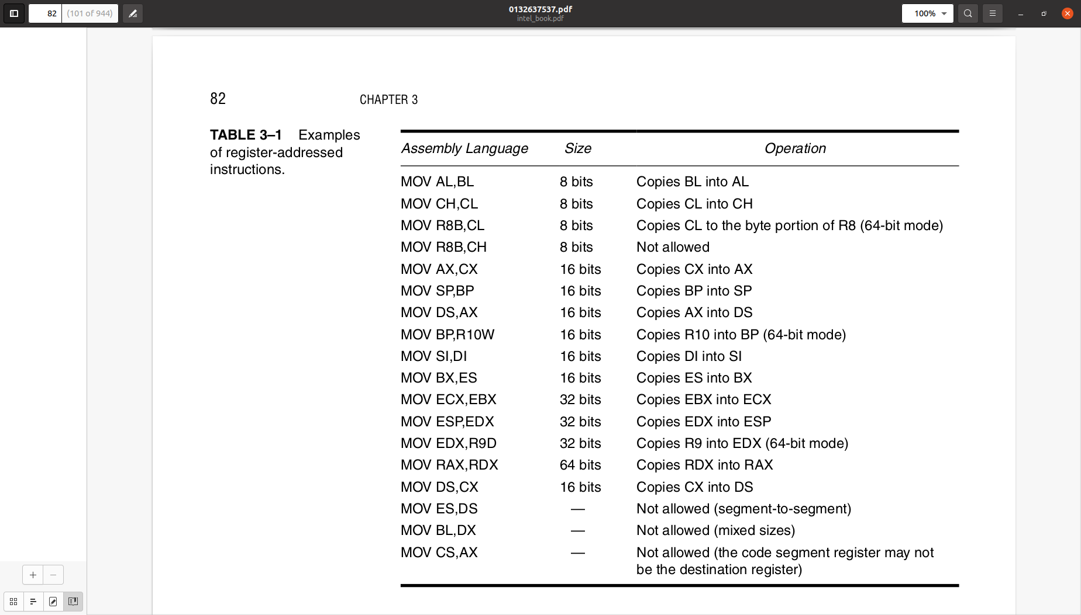

Slide 17
the source register’s contents do not change, but the destination register’s contents do change
This instruction moves (copies) a l234H from register CX into register BX.
This erases the old contents (76AFH) of register BX, but the contents of CX remain unchanged.
The contents of the destination register or destination memory location change for all instructions except the CMP and TEST instructions.
Note that the MOV BX, CX instruction does not affect the leftmost 16 bits of register EBX.

Slide 18
Immediate Addressing
The term immediate implies that the data immediately follow the hexadecimal opcode in the memory.
immediate data are constant data, whereas the data transferred from a register or memory location are variable data
Immediate addressing operates upon a byte or word of data
The MOV immediate instruction transfers a copy of the immediate data into a register or a memory location.

Slide 19
Each statement in an assembly language program consists of four parts or fields
The leftmost field is called the label and it is used to store a symbolic name for the memory location that it represents.
All labels must begin with a letter or one of the following special characters: @, $, -, or ? A label may be of any length from 1 to 35 characters.
The label appears in a program to identify the name of a memory location for storing data.
The next field to the right is called the opcode field; it is designed to hold the instruction, or opcode.
The MOV part of the move data instruction is an example of an opcode.
To the right of the opcode field is the operand field, which contains information used by the opcode
MOV AL,BL instruction has the opcode MOV and operands AL and BL
some instructions contain between zero and three operands
The final field, the comment field, contains a comment about an instruction or a group of instructions.
A comment always begins with a semicolon (;)

Slide 20
Direct Data Addressing
There are two basic forms of direct data addressing:
(1) direct addressing, which applies to a MOV between a memory location and AL, AX, or EAX, and (2) displacement addressing, which applies to almost any instruction in the instruction set.
In either case, the address is formed by adding the displacement to the default data segment address or an alternate segment address.

Slide 21
Direct Addressing
Direct addressing with a MOV instruction transfers data between a memory location, located within the data segment, and the AL (8-bit), AX (l6-bit), or EAX (32-bit) register.
A MOV instruction using this type of addressing is usually a 3-byte long instruction.

Slide 22
The MOV AL,DATA instruction, as represented by most assemblers, loads AL from the data segment memory location DATA (1234H).
Memory location DATA is a symbolic memory location, while the 1234H is the actual hexadecimal location.
With many assemblers, this instruction is represented as a MOV AL,[1234H] instruction.
The [1234H] is an absolute memory location that is not allowed by all assembler programs.
Note that this may need to be formed as MOV AL, DS:[1234H] with some assemblers, to show that the address is in the data segment.
The effective address is formed by adding 1234H (the offset address) and 10000H (the data segment address of 1000H times 10H) in a system operating in the real mode.

Slide 23
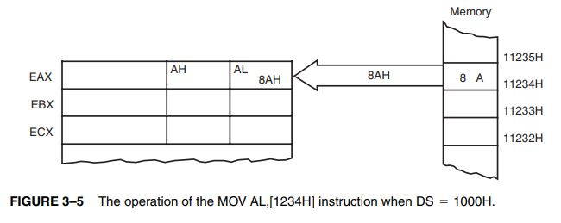

Slide 24
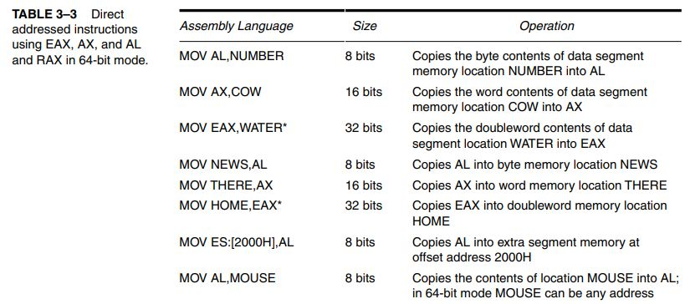
Direct

Slide 25

Displacement Addressing
Displacement addressing is almost identical to direct addressing, except that the instruction is 4 bytes wide instead of 3.
MOV CL,DS:[1234H]
MOV AL,DS:[1234H]
both basically perform the same operation except for the destination register (CL versus AL).
Another difference only becomes apparent upon examining the assembled versions of these two instructions.
MOV AL,DS:[1234H] instruction is 3 bytes long
MOV CL,DS:[1234H] instruction is 4 bytes long
This example shows how the assembler converts these two instructions into hexadecimal machine language.
You must include the segment register DS: in this example, before the [offset] part of the instruction. You may use any segment register, but in most cases, data are stored in the data segment, so this example uses DS:[1234H].

Slide 26
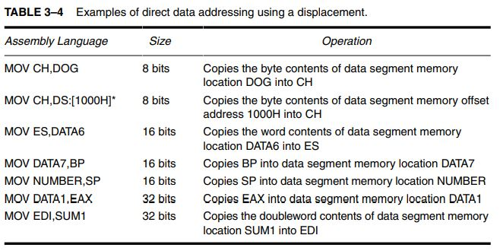

Slide 27
Register Indirect Addressing
Register indirect addressing allows data to be addressed at any memory location through an offset address held in any of the following registers: BP, BX, DI, and SI.
For example, if register BX contains 1000H and the MOV AX,[BX] instruction executes, the word contents of data segment offset address 1000H are copied into register AX.
The [ ] symbols denote indirect addressing in assembly language.
The data segment is used by default with register indirect addressing or any other addressing mode that uses BX, DI, or SI to address memory.
If the BP register addresses memory, the stack segment is used by default

Slide 28
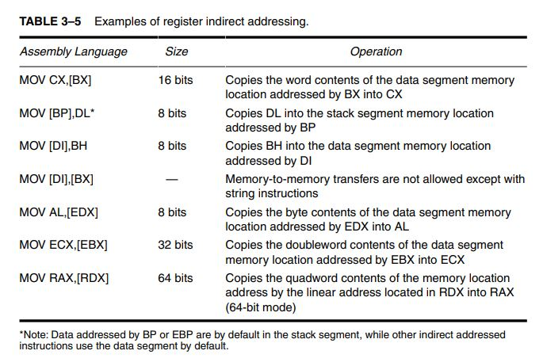

Slide 29
In some cases, indirect addressing requires specifying the size of the data.
The size is specified by the special assembler directive BYTE PTR, WORD PTR, DWORD PTR, or QWORD PTR.
These directives indicate the size of the memory data addressed by the memory pointer (PTR).
For example, the MOV AL,[DI] instruction is clearly a byte-sized move instruction, but the MOV [DI],10H instruction is ambiguous.
Does the MOV [DI],10H instruction address a byte-, word-, doubleword-, or quadword-sized memory location?
The assembler can’t determine the size of the 10H.
The instruction MOV BYTE PTR [DI],10H clearly designates the location addressed by DI as a byte-sized memory location.
Likewise, the MOV DWORD PTR [DI],10H clearly identifies the memory location as doubleword-sized.
The BYTE PTR, WORD PTR, DWORD PTR, and QWORD PTR directives are used only with instructions that address a memory location through a pointer or index register with immediate data

Slide 30
Indirect addressing often allows a program to refer to tabular data located in the memory system.
For example, suppose that you must create a table of information that contains 50 samples taken from memory location 0000:046C.
load the starting location of the table into the BX register with a MOV immediate instruction.
After initializing the starting address of the table, use register indirect addressing to store the 50 samples sequentially

Slide 31
Base-plus-index addressing
Base-plus-index addressing is similar to indirect addressing because it indirectly addresses memory data.
In the 8086 through the 80286, this type of addressing uses one base register (BP or BX) and one index register (DI or SI) to indirectly address memory.
The base register often holds the beginning location of a memory array, whereas the index register holds the relative position of an element in the array.
whenever BP addresses memory data, both the stack segment register and BP generate the effective address

Slide 32
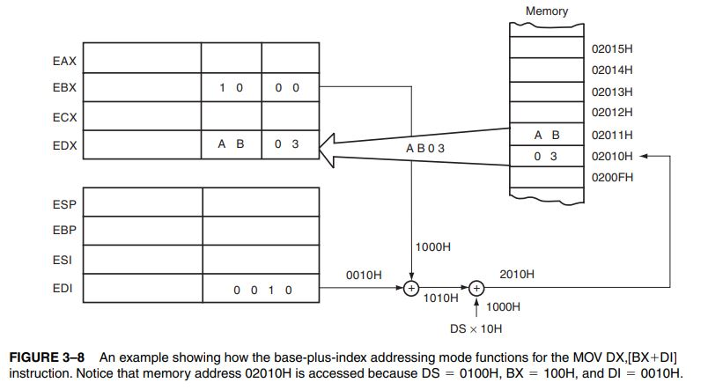

Slide 33
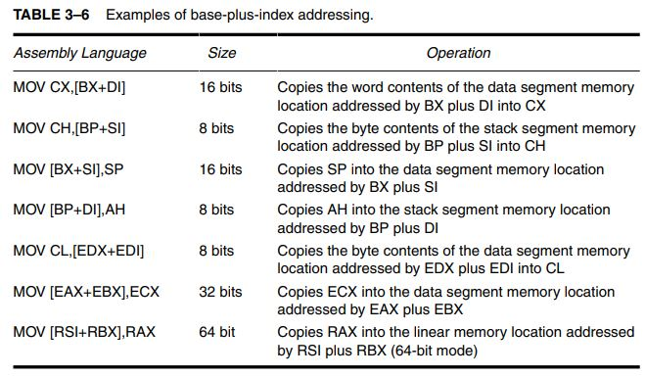

Slide 34
A major use of the base-plus-index addressing mode is to address elements in a memory array.
Suppose that the elements in an array located in the data segment at memory location ARRAY must be accessed.
To accomplish this, load the BX register (base) with the beginning address of the array and the DI register (index) with the element number to be accessed.

Slide 35
